Slide 1
Collaborative Personalized Twitter Search with Topic-Language Models
Jan Vosecky, Kenneth Wai-Ting Leung, Wilfred Ng
Department of Computer Science and Engineering
Hong Kong University of Science and Technology
Presented by: @milson

Slide 2
Keywords
Collaborative personalized search
Topic modeling
Language modeling
Twitter - Microblogging social site
- “The SMS of the Internet”.

Slide 3
Most popular accounts
As of January 24, 2015:
Katy Perry- 63,810,164 followers
Justin Bieber- 59,563,491
Barack Obama- 53,604,487
Taylor Swift- 51,132,675
YouTube- 48,336,985
Lady Gaga- 43,767,701
Justin Timberlake- 40,717,526
Britney Spears- 40,492,723
Rihanna- 39,639,895
Ellen DeGeneres- 38,153,326

Slide 4
Introduction
Challenges:
Highly social
Diversity of topics and purposes
Data sparseness
Dynamic and real-time
Solution:
Collaborative Personalized Twitter Search (CPTS)

Slide 5
Features of CPTS
Collaborative User Modeling
- Sparseness of individual user’s data
- The cold-start problem
Topic-Specific Language Modeling
- Query disambiguation - the latent meaning
- Personalized re-ranking
- Input for CM – user’s preferences
Integrated Posting-Search Model
Responsive and Dynamic Profiles
- Dynamically updatable
- No explicit input from the users

Slide 6



Preliminaries
Language Modeling IR
- Query Likelihood model
Topic Modeling and IR
State-of-the-art topic models LDA:
linear combination of TM and document LM
Problems:
- Short length and diverse and coarse topics of tweets

Slide 7
Proposed framework
Scope:
Given a microblog user u, a search query Q and a set of N microblog documents returned by a base search engine, our goal is to re-rank the documents using query Q and a user model Mu, such that documents matching the user’s interests are ranked at top positions.
Goal:
To solve two basic problems:
(1) how to construct the user model Mu
(2) how to utilize this model for document ranking.
- a document refers to a single microblog message (i.e., a tweet).
- user preferences - topics

Slide 8
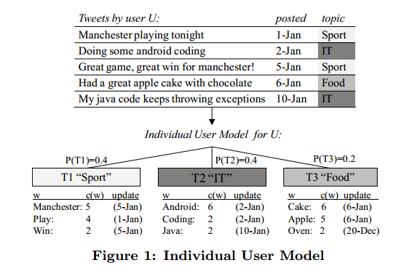
Modeling an Individual User
A two-layer user model
- topic layer
- word layer

Slide 9
Basic Personalization Model
Decomposes the ranking into two components
- Query disambiguation
we predict which underlying topic the user had in mind when formulating the query.
- Probability given topic k is multiplied with the probability that document D belongs to the respective topic in u’s IM.

Slide 10
Collaborative User Modeling
If a user finds a tweet interesting, they are able to re-tweet it or add it to their favorites. Furthermore, users can have conversations or mention each other in their tweets.
Increase the completeness of the user model and tackle data sparseness of an individual user
Weighting factors (popularity, aﬃnity, topic-interaction and topic bias)

Slide 11
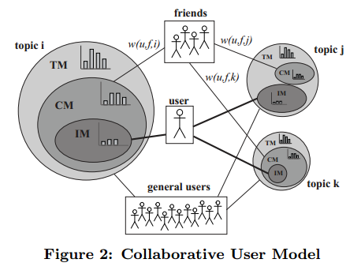

Creating the CM
After obtaining the weight of each friend of u, we construct the Collaborative User Model(CM). Basically, we take the weighted average of all the individual user models of u’s friends.
The collaborative personalized ranking function

Slide 12
Modeling Search Behavior
Model the user’s search activity and construct the Search User Model (SM)
User’s interest – user’s feedback on the search results
- re-tweeting (re-sending) or “favorit-ing” an interesting tweet, or clicking a URL within the tweet.
Feedbacks:
- Topic level feedback - user’s search bias towards topic k
- Topic-word level feedback - user’s preference for words in topic k
- Query-topic feedback - user’s preference for topic k when issuing query Q

Slide 13
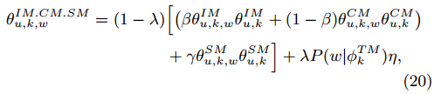

Full Ranking Function
The search user model can now be integrated with IM and CM by a weighted sum as follows
The full ranking function for collaborative personalized search is defined as

Slide 14
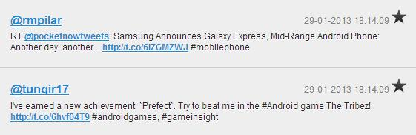
Experimental evaluation
Datasets
Background Twitter Corpus
- crawled a total of 44.5 million tweets over the course of 6 months in 2013. After filtering non-English language tweets and removing tweets of less than 20 characters in length, dataset contained 11.7 million tweets
Twitter Search Query Logs
Query Log 1: Controlled User Study (Log_CoS)
- 11 active Twitter users
- 2 Days
- Day 1 - training dataset and Day 2 - testing dataset.
- four Query types: recency, topical, entity-oriented and ambiguous

Slide 15
Query Log 2: In-the-Wild User Study (Log_IwS)
24 users invited
over a 3-month period
at least 10 queries

Slide 16
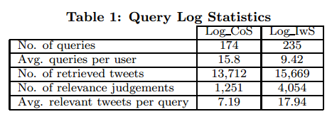
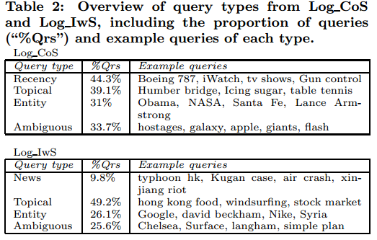
Statistics
overall statistics of the obtained query log
In addition to the query log data, they also crawl the users’ Twitter data. Specifically, they obtain the latest 200 tweets of each user and crawl the tweets of the top-20 friends, ranked by friend weight

Slide 17
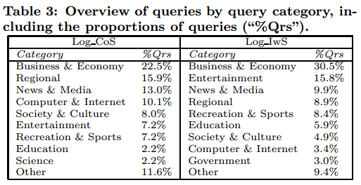
More Statistics …
The distribution of queries by category

Slide 18
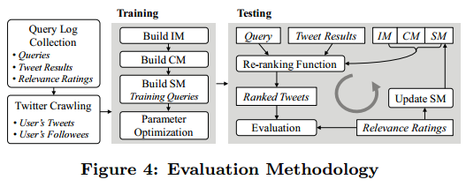
Evaluation Methodology

Slide 19
Overview of Models and Baselines
Baseline models
Query Likelihood (B-QL) - Standard language modeling approach - Used for ranking tweets
Topic Model-based IR (B-TM) - Ranking based on the Topic Model and a background language model
Personalized Search (B-PS) - Personalized ranking based on a single-layer user language model - used for personalizing Web search
Collaborative Search (B-CS) - preferences of a group of users - basis of collaborative Web search
Collaborative Personalized Search (B-CPS) - collaborative personalized Web search - both the user’s LM and the collaborative LM are integrated.

Slide 20
Proposed Models
CPTS-IM. Ranking using the Individual User Model
CPTS-CM. Ranking using the Collaborative User Model
CPTS-SM. Ranking using the Search Model
CPTS-All. Full Collaborative Personalized Search Model

Slide 21
Metrics
Ranking performance is evaluated using two standard metrics
- Normalized Discounted Cumulative Gain (NDCG)
- Mean Average Precision (MAP).

Slide 22
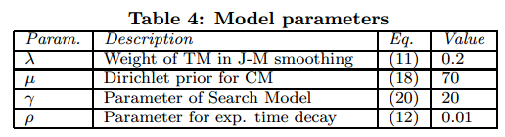
Parameter Setting
Commonly used in probabilistic frameworks
Optimize the global parameters for CPTS
Optimizing one parameter at a time, while keeping all other parameters fixed

Slide 23
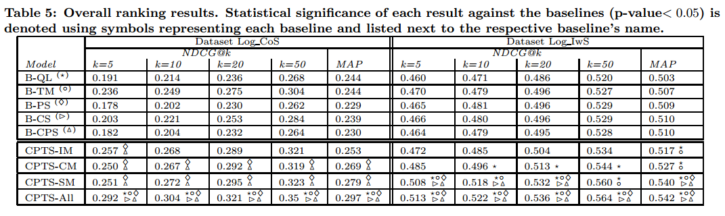
Results and Discussion

Slide 24
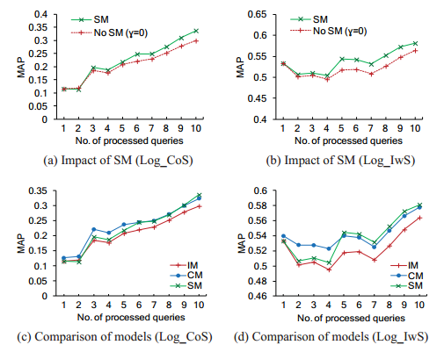
Comparison Among Proposed Models

Slide 25
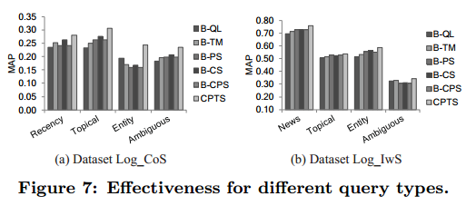
Ranking Performance by Query Types
The eﬀectiveness of the framework when dealing with diﬀerent types of queries

Slide 26
Conclusion
A novel probabilistic framework for Collaborative Personalized Twitter Search.
The user’s posting and searching preferences.
A topic-sensitive collaborative user model to improve ranking performance.
A new two-layer user model structure, which effectively handles the diversity of microblog users’ preferences.
Experimental evaluation

Slide 27
Future work
To use document-specific and author-specific features in the ranking function
To categorize the query types - query-dependent personalization strategies.
Incorporate more features into our framework, such as spatial and temporal dimensions of user preferences.

Slide 28

Thank you!

